Slide 1
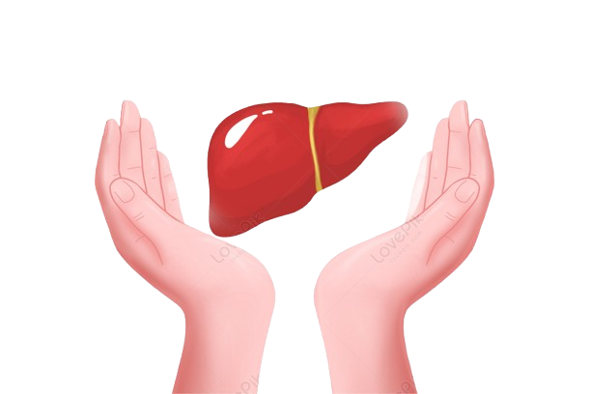
Liver Disease Prediction
🔹🔹🔹🔹🔹🔹

Slide 2
P475 Group 4 Mentor name :- DilavaR basha k
Snehal Atpadkar
Pathipati Venkata Sai
chamakura sai kumar
Ankit Kailash Dhivar
Esther Evangeline
Nazmeen B

Slide 3
Index
Intro
Eda
Model Building
Model Evaluation and accuracy
Deployment
Conclusion
Problems faced

Slide 4
Introduction
Patient data such as demographics, medical history, and biochemical indicators like liver enzyme levels (e.g., ALT, AST), bilirubin, albumin, and others, are analysed.
This is a multiclass classification problem where patients are categorized into groups like hepatitis, cirrhosis, no disease, suspect disease, fibrosis.

Slide 5
Exploratory Data Analysis
Dataset Overview: The analysis was conducted on a dataset comprising 12 predictors and 615 entries.
Handling Missing Values: Missing values were managed by imputing the median or removing a few entries, as they showed no correlation with other variables.
Class Imbalance: The data was imbalanced, with the majority belonging to the 'no disease' category (533 entries).
Outlier Treatment: Outliers were handled using the Interquartile Range (IQR) method to ensure robust analysis.
Feature Correlation: No strong correlations were observed among the features, suggesting the presence of a complex pattern that machine learning techniques could help uncover.

Slide 6
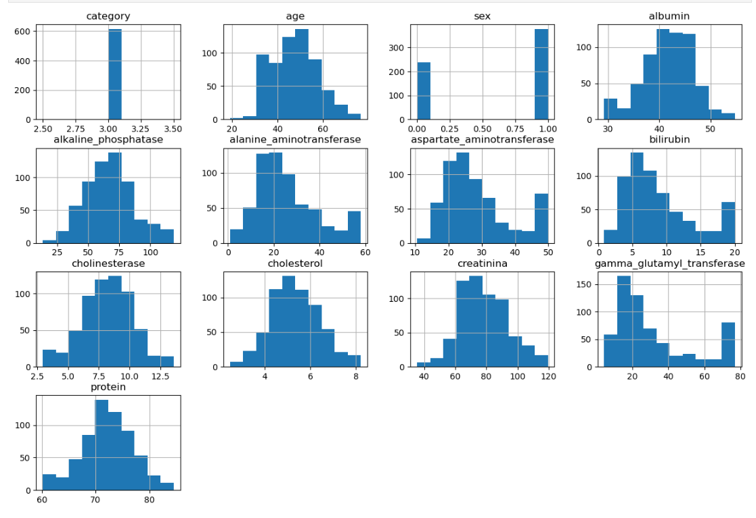

Slide 7
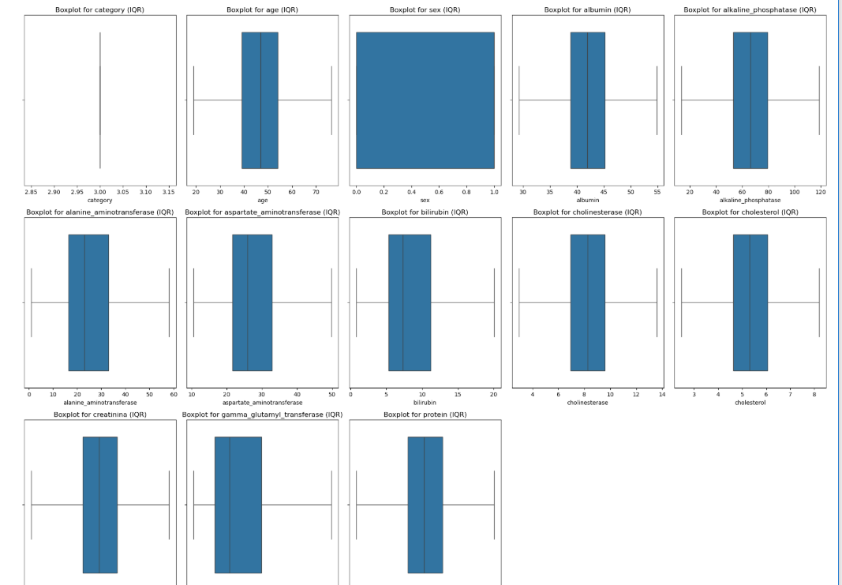

Slide 8
Model Building
For model building, we employed various algorithms, including Random Forest, Decision Tree, boosting methods like (XGBoost and LightGBM), Support Vector Machine (SVM), K-Nearest Neighbors (KNN).
The performance of each model was evaluated by comparing their testing accuracy scores to determine the most effective approach for liver disease classification.

Slide 9
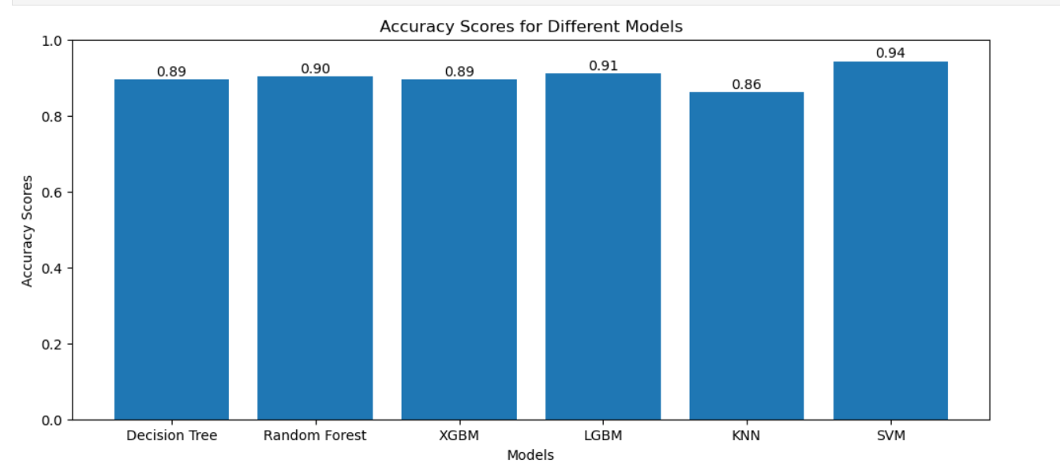
Based on the test accuracy scores, we selected SVM for further evaluation, as they achieved the highest test accuracy of 0.94.

Slide 10
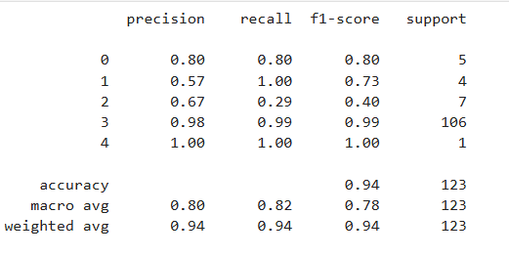
Model Evaluation
SVM
Test accuracy: 0.943
Training accuracy : 0.9754
Parameters used:
1. kernel = linear
2. C = 1

Slide 11
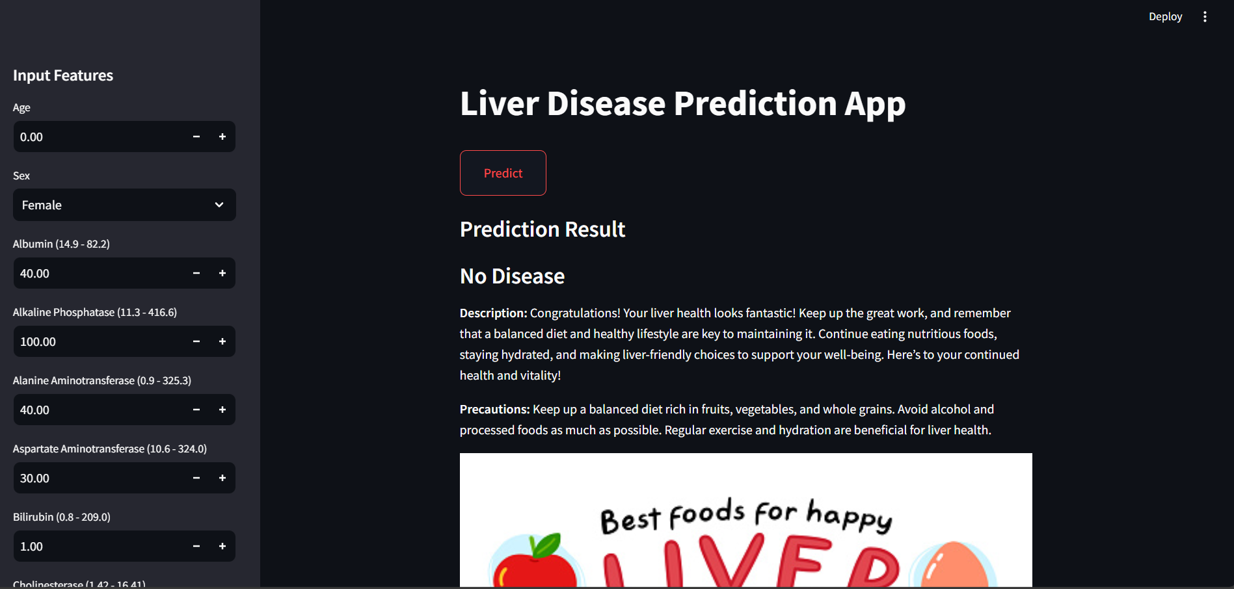
Deployment using Streamlit

Slide 12
Problems Faced
Data Imbalance:
Most records indicated no liver disease, making it difficult to train the model accurately.
Solution: Used scaling techniques to improve prediction accuracy.
Limited Dataset Size:
Small dataset size challenged model reliability.
Solution: Enhanced model performance through scaling and data preprocessing
Deployment Challenges:
Ensured accurate real-time predictions in Streamlit by implementing data scaling at deployment.

Slide 13
Conclusion
Approach:
Loaded and cleaned the dataset in Jupyter Notebook.
Performed exploratory data analysis (EDA) to understand data patterns.
Tested multiple models, selecting SVM for its high accuracy.
Deployed the model using Streamlit for real-time predictions.
Outcomes:
The deployed model reliably predicts liver disease risk.
Provides a probability score to guide users, while emphasizing that results should be confirmed by a healthcare professional.
The system helps users understand potential liver health risks and encourages preventive care.

Slide 14
THANK YOU

